Slide 1
UNIT - I TOPIC –Introduction to Algorithm
BRANCH - CSE SEMESTER – 6th
SUBJECT- DAA

Slide 2
Table of contents
01
02
Characteristics of algorithm
Analysis of algorithm
03
04
Substitution method, Recursion tree method
Masters’ theorem.

Slide 3
Algorithm
Algorithm is a step-by-step procedure, which defines a set of instructions to be executed in a certain order to get the desired output.
Algorithms are generally created independent of underlying languages, i.e. an algorithm can be implemented in more than one programming language.

Slide 4
Algorithm
From the data structure point of view, following are some important categories of algorithms −
Search − Algorithm to search an item in a data structure.
Sort − Algorithm to sort items in a certain order.
Insert − Algorithm to insert item in a data structure.
Update − Algorithm to update an existing item in a data structure.
Delete − Algorithm to delete an existing item from a data structure.

Slide 5
Characteristics of an Algorithm
Not all procedures can be called an algorithm. An algorithm should have the following characteristics −
Unambiguous − Algorithm should be clear and unambiguous. Each of its steps (or phases), and their inputs/outputs should be clear and must lead to only one meaning.
Input − An algorithm should have 0 or more well-defined inputs.
Output − An algorithm should have 1 or more well-defined outputs, and should match the desired output.
Finiteness − Algorithms must terminate after a finite number of steps.
Feasibility − Should be feasible with the available resources.
Independent − An algorithm should have step-by-step directions, which should be independent of any programming code.

Slide 6
Algorithm Analysis
Efficiency of an algorithm can be analyzed at two different stages, before implementation and after implementation. They are the following −
A Priori Analysis − This is a theoretical analysis of an algorithm. Efficiency of an algorithm is measured by assuming that all other factors, for example, processor speed, are constant and have no effect on the implementation.
A Posterior Analysis − This is an empirical analysis of an algorithm. The selected algorithm is implemented using programming language. This is then executed on target computer machine. In this analysis, actual statistics like running time and space required, are collected.

Slide 7
Algorithm Complexity
Suppose X is an algorithm and n is the size of input data, the time and space used by the algorithm X are the two main factors, which decide the efficiency of X.
Time Factor − Time is measured by counting the number of key operations such as comparisons in the sorting algorithm.
Space Factor − Space is measured by counting the maximum memory space required by the algorithm.
The complexity of an algorithm f(n) gives the running time and/or the storage space required by the algorithm in terms of n as the size of input data.

Slide 8
Space Complexity
Space complexity of an algorithm represents the amount of memory space required by the algorithm in its life cycle. The space required by an algorithm is equal to the sum of the following two components −
A fixed part that is a space required to store certain data and variables, that are independent of the size of the problem. For example, simple variables and constants used, program size, etc.
A variable part is a space required by variables, whose size depends on the size of the problem. For example, dynamic memory allocation, recursion stack space, etc.

Slide 9
Space complexity S(P) of any algorithm P is S(P) = C + SP(I), where C is the fixed part and S(I) is the variable part of the algorithm, which depends on instance characteristic I. Following is a simple example that tries to explain the concept −
Algorithm: SUM(A, B)
Step 1 - START
Step 2 - C ← A + B + 10
Step 3 - Stop
Here we have three variables A, B, and C and one constant. Hence
S(P) = 1 + 3. Now, space depends on data types of given variables and constant types and it will be multiplied accordingly.

Slide 10
Time Complexity
Time complexity of an algorithm represents the amount of time required by the algorithm to run to completion. Time requirements can be defined as a numerical function T(n), where T(n) can be measured as the number of steps, provided each step consumes constant time.
For example, addition of two n-bit integers takes n steps. Consequently, the total computational time is T(n) = c ∗ n, where c is the time taken for the addition of two bits. Here, we observe that T(n) grows linearly as the input size increases.

Slide 11
Asymptotic Analysis
Asymptotic analysis of an algorithm refers to defining the mathematical boundation/framing of its run-time performance. Using asymptotic analysis, we can very well conclude the best case, average case, and worst case scenario of an algorithm.
Asymptotic analysis is input bound i.e., if there's no input to the algorithm, it is concluded to work in a constant time. Other than the "input" all other factors are considered constant.
Asymptotic analysis refers to computing the running time of any operation in mathematical units of computation. For example, the running time of one operation is computed as f(n) and may be for another operation it is computed as g(n²). This means the first operation running time will increase linearly with the increase in n and the running time of the second operation will increase exponentially when n increases. Similarly, the running time of both operations will be nearly the same if n is significantly small.

Slide 12
Usually, the time required by an algorithm falls under three types −
Best Case − Minimum time required for program execution.
Average Case − Average time required for program execution.
Worst Case − Maximum time required for program execution.

Slide 13
Asymptotic Notations
Following are the commonly used asymptotic notations to calculate the running time complexity of an algorithm.
Ο Notation
Ω Notation
θ Notation

Slide 14
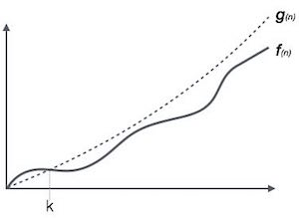
Big Oh Notation, Ο
The notation Ο(n) is the formal way to express the upper bound of an algorithm's running time. It measures the worst case time complexity or the longest amount of time an algorithm can possibly take to complete.
For example, for a function f(n)
Ο(f(n)) = { g(n) : there exists c > 0 and n₀ such that f(n) ≤ c.g(n) for all n > n₀. }

Slide 15
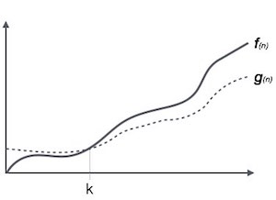
Omega Notation, Ω
The notation Ω(n) is the formal way to express the lower bound of an algorithm's running time. It measures the best case time complexity or the best amount of time an algorithm can possibly take to complete.
For example, for a function f(n)
Ω(f(n)) ≥ { g(n) : there exists c > 0 and n₀ such that g(n) ≤ c.f(n) for all n > n₀. }

Slide 16
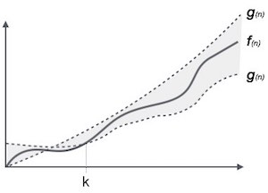
Theta Notation, θ
The notation θ(n) is the formal way to express both the lower bound and the upper bound of an algorithm's running time.
It is represented as follows −
θ(f(n)) = { g(n) if and only if g(n) = Ο(f(n)) and g(n) = Ω(f(n)) for all n > n₀. }

Slide 17
Common Asymptotic Notations
Following is a list of some common asymptotic notations −
constant | − | Ο(1)
logarithmic | − | Ο(log n)
linear | − | Ο(n)
n log n | − | Ο(n log n)
quadratic | − | Ο(n²)
cubic | − | Ο(n³)
polynomial | − | n^{Ο(1)}
exponential | − | 2^{Ο(n)}

Slide 18
Recursion Tree Method
1. Recursion Tree Method is a pictorial representation of an iteration method which is in the form of a tree where at each level nodes are expanded.
2. In general, we consider the second term in recurrence as root.
3. It is useful when the divide & Conquer algorithm is used.
4. It is sometimes difficult to come up with a good guess. In Recursion tree, each root and child represents the cost of a single subproblem.
5. We sum the costs within each of the levels of the tree to obtain a set of pre-level costs and then sum all pre-level costs to determine the total cost of all levels of the recursion.
6. A Recursion Tree is best used to generate a good guess, which can be verified by the Substitution Method.

Slide 19
Example 1
Consider T (n) = 2T + n²
We have to obtain the asymptotic bound using recursion tree method.
Solution: The Recursion tree for the above recurrence is

Slide 20
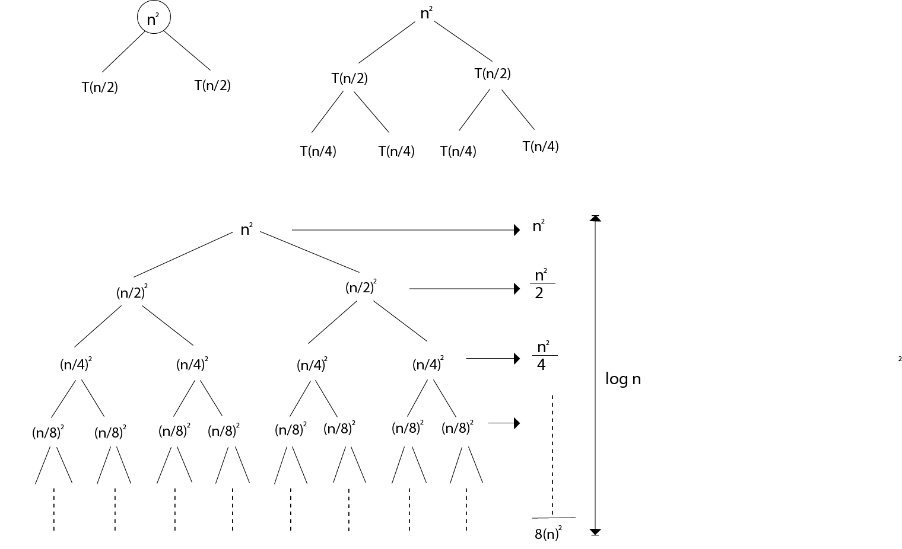

Slide 21
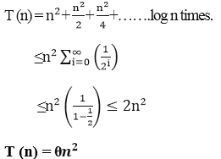

Slide 22
Master Method
The Master Method is used for solving the following types of recurrence
T (n) = a T+ f (n) with a≥1 and b≥1 be constant & f(n) be a function and can be interpreted as
Let T (n) is defined on non-negative integers by the recurrence.
T (n) = a T+ f (n)
In the function to the analysis of a recursive algorithm, the constants and function take on the following significance:

Slide 23
In the function to the analysis of a recursive algorithm, the constants and function take on the following significance:
n is the size of the problem.
a is the number of subproblems in the recursion.
n/b is the size of each subproblem. (Here it is assumed that all subproblems are essentially the same size.)
f (n) is the sum of the work done outside the recursive calls, which includes the sum of dividing the problem and the sum of combining the solutions to the subproblems.
It is not possible always bound the function according to the requirement, so we make three cases which will tell us what kind of bound we can apply on the function.

Slide 24
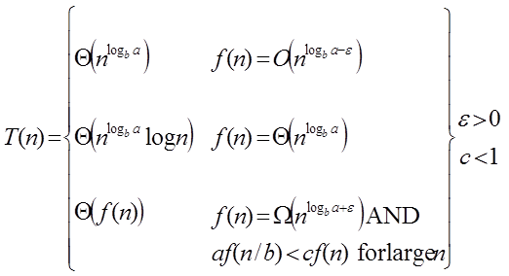
Master Theorem:
It is possible to complete an asymptotic tight bound in these three cases:

Slide 25
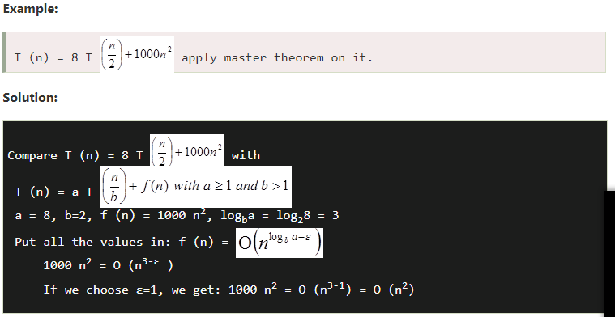
Since this equation holds, the first case of the master theorem applies to the given recurrence relation,
thus resulting in the conclusion:

Slide 26
UNIT - II TOPIC –Fundamental Algorithmic Strategies
BRANCH - CSE SEMESTER – 6th
SUBJECT- DAA

Slide 27
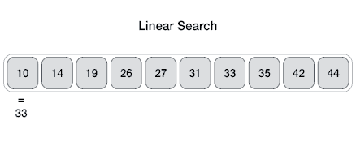
Linear Search
Linear search is a very simple search algorithm. In this type of search, a sequential search is made over all items one by one. Every item is checked and if a match is found then that particular item is returned, otherwise the search continues till the end of the data collection.

Slide 28
Algorithm
Linear Search ( Array A, Value x)
Step 1: Set i to 1
Step 2: if i > n then go to step 7
Step 3: if A[i] = x then go to step 6
Step 4: Set i to i + 1
Step 5: Go to Step 2
Step 6: Print Element x Found at index i and go to step 8
Step 7: Print element not found
Step 8: Exit

Slide 29
Pseudocode
procedure linear_search (list, value)
for each item in the list
if match item == value
return the item's location
end if end for
end procedure
For c program click here : https://www.tutorialspoint.com/data_structures_algorithms/linear_search_program_in_c.htm

Slide 30
Insertion Sort
Insertion sort is one of the simplest sorting algorithms for the reason that it sorts a single element at a particular instance. It is not the best sorting algorithm in terms of performance, but it's slightly more efficient than selection sort and bubble sort in practical scenarios. It is an intuitive sorting technique.
Let's consider the example of cards to have a better understanding of the logic behind the insertion sort.
Suppose we have a set of cards in our hand, such that we want to arrange these cards in ascending order. To sort these cards, we have a number of intuitive ways.
One such thing we can do is initially we can hold all of the cards in our left hand, and we can start taking cards one after other from the left hand, followed by building a sorted arrangement in the right hand.

Slide 31
ALGORITHM: INSERTION SORT (A)
1. for j = 2 to A.length
2. key = A[j]
3. // Insert A[j] into the sorted sequence A[1.. j - 1]
4. i = j - 1
5. while i > 0 and A[i] > key
6. A[i + 1] = A[i]
7. ii = i -1
8. A[i + 1] = key

Slide 32
A = (41, 22, 63, 14, 55, 36)
Initially,
1st Iteration:
Set key = 22
Compare a1 with a0\
Since a0 > a1, swap both of them.

Slide 33
2nd Iteration:
Set key = 63
Compare a2 with a1 and a0
Since a2 > a1 > a0, keep the array as it is.

Slide 34
3rd Iteration:
Set key = 14
Compare a3 with a2, a1 and a0
Since a3 is the smallest among all the elements on the left-hand side, place a3 at the beginning of the array.

Slide 35
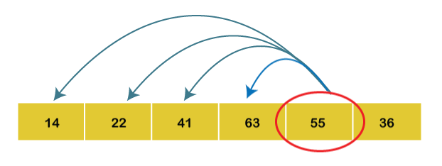
4th Iteration:
Set key = 55
Compare a4 with a3, a2, a1 and a0.
As a4 < a3, swap both of them.

Slide 36
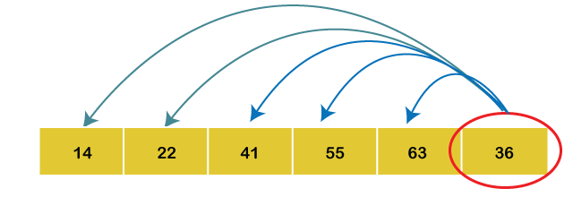
5th Iteration:
Set key = 36
Compare a5 with a4, a3, a2, a1 and a0.
Since a5 < a2, so we will place the elements in their correct positions.
Hence the array is arranged in ascending order, so no more swapping is required.

Slide 37
Complexity Analysis of Insertion Sort
Input: Given n input elements.
Output: Number of steps incurred to sort a list.
Logic: If we are given n elements, then in the first pass, it will make n-1 comparisons; in the second pass, it will do n-2; in the third pass, it will do n-3 and so on. Thus, the total number of comparisons can be found by;
Output; (n-1) + (n-2) + (n-3) + (n-4) + ...... + 1
Sum= i.e., O(n²)
Therefore, the insertion sort algorithm encompasses a time complexity of O(n²) and a space complexity of O(1) because it necessitates some extra memory space for a key variable to perform swaps.

Slide 38
Time Complexities:
Best Case Complexity: The insertion sort algorithm has a best-case time complexity of O(n) for the already sorted array because here, only the outer loop is running n times, and the inner loop is kept still.
Average Case Complexity: The average-case time complexity for the insertion sort algorithm is O(n²), which is incurred when the existing elements are in jumbled order, i.e., neither in the ascending order nor in the descending order.
Worst Case Complexity: The worst-case time complexity is also O(n²), which occurs when we sort the ascending order of an array into the descending order. In this algorithm, every individual element is compared with the rest of the elements, due to which n-1 comparisons are made for every n^{th} element.
The insertion sort algorithm is highly recommended, especially when a few elements are left for sorting or in case the array encompasses few elements.

Slide 39
Space Complexity
The insertion sort encompasses a space complexity of O(1) due to the usage of an extra variable key.
Insertion Sort Applications
The insertion sort algorithm is used in the following cases:
When the array contains only a few elements.
When there exist few elements to sort.

Slide 40
Advantages of Insertion Sort
It is simple to implement.
It is efficient on small datasets.
It is stable (does not change the relative order of elements with equal keys)
It is in-place (only requires a constant amount O (1) of extra memory space).
It is an online algorithm, which can sort a list when it is received.

Slide 41
Greedy Algorithm Introduction
"Greedy Method finds out of many options, but you have to choose the best option."
In this method, we have to find out the best method/option out of many present ways.
In this approach/method we focus on the first stage and decide the output, don't think about the future.
This method may or may not give the best output.

Slide 42
Greedy Algorithm solves problems by making the best choice that seems best at the particular moment. Many optimization problems can be determined using a greedy algorithm. Some issues have no efficient solution, but a greedy algorithm may provide a solution that is close to optimal. A greedy algorithm works if a problem exhibits the following two properties:
Greedy Choice Property: A globally optimal solution can be reached at by creating a locally optimal solution. In other words, an optimal solution can be obtained by creating "greedy" choices.
Optimal substructure: Optimal solutions contain optimal sub solutions. In other words, answers to subproblems of an optimal solution are optimal.

Slide 43
Example:
machine scheduling
Fractional Knapsack Problem
Minimum Spanning Tree
Huffman Code
Job Sequencing
Activity Selection Problem

Slide 44
Steps for achieving a Greedy Algorithm are:
Feasible: Here we check whether it satisfies all possible constraints or not, to obtain at least one solution to our problems.
Local Optimal Choice: In this, the choice should be the optimum which is selected from the currently available
Unalterable: Once the decision is made, at any subsequence step that option is not altered.

Slide 45
Huffman Codes
(i) Data can be encoded efficiently using Huffman Codes.
(ii) It is a widely used and beneficial technique for compressing data.
(iii) Huffman's greedy algorithm uses a table of the frequencies of occurrences of each character to build up an optimal way of representing each character as a binary string.

Slide 46
Suppose we have 10⁵ characters in a data file. Normal Storage: 8 bits per character (ASCII) - 8 x 10⁵ bits in a file. But we want to compress the file and save it compactly. Suppose only six characters appear in the file:
How can we represent the data in a Compact way?

Slide 47
(i) Fixed length Code: Each letter represented by an equal number of bits. With a fixed length code, at least 3 bits per character:
For example:
For a file with 10⁵ characters, we need 3 x 10⁵ bits.
a | 000
b | 001
c | 010
d | 011
e | 100
f | 101

Slide 48
(ii) A variable-length code: It can do considerably better than a fixed-length code, by giving many characters short code words and infrequent character long codewords.
For example:
Number of bits = (45 x 1 + 13 x 3 + 12 x 3 + 16 x 3 + 9 x 4 + 5 x 4) x 1000 = 2.24 x 10⁵bits
Thus, 224,000 bits to represent the file, a saving of approximately 25%.This is an optimal character code for this file.
a | 0
b | 101
c | 100
d | 111
e | 1101
f | 1100

Slide 49
Algorithm of Huffman Code
Huffman (C)
n=|C|
2. Q ← C
3. for i=1 to n-1
4. do
5. z= allocate-Node ()
6. x= left[z]=Extract-Min(Q)
7. y= right[z] =Extract-Min(Q)
8. f [z]=f[x]+f[y]
9. Insert (Q, z)
10. return Extract-Min (Q)

Slide 50
Example: Find an optimal Huffman Code for the following set of frequencies:
a: 50 b: 25 c: 15 d: 40 e: 75
Solution:

Slide 51
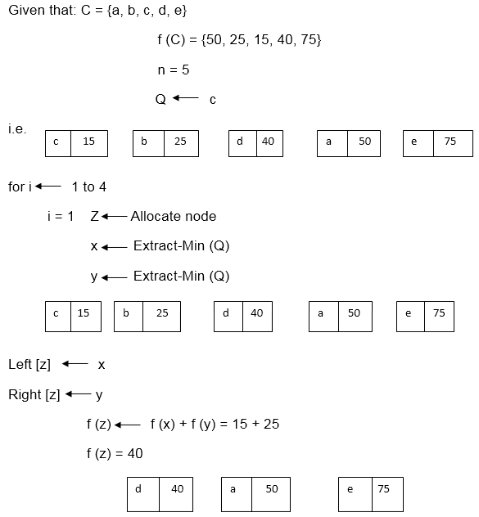

Slide 52
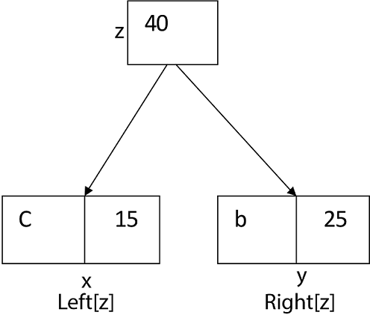
i.e.

Slide 53
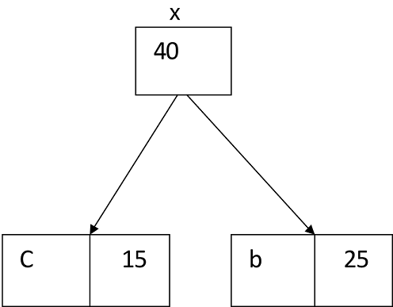
Again for i=2

Slide 54
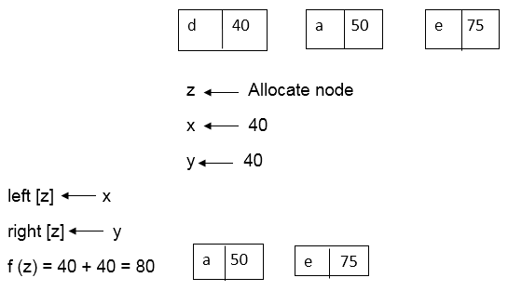

Slide 55
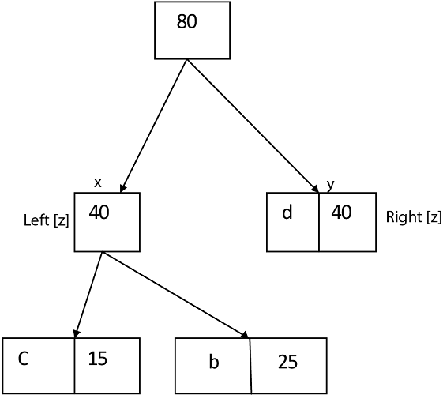
Similarly, we apply the same process we get

Slide 56
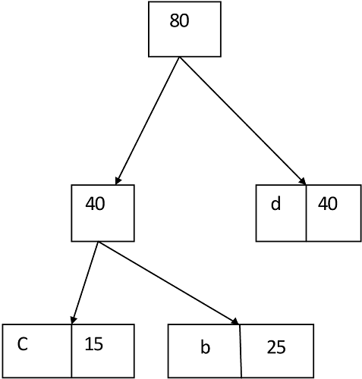

Slide 57
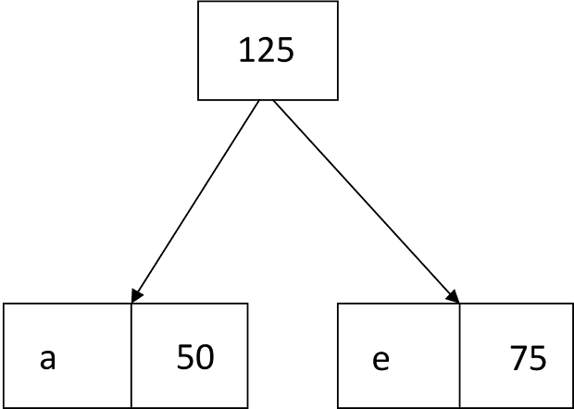
bfg

Slide 58
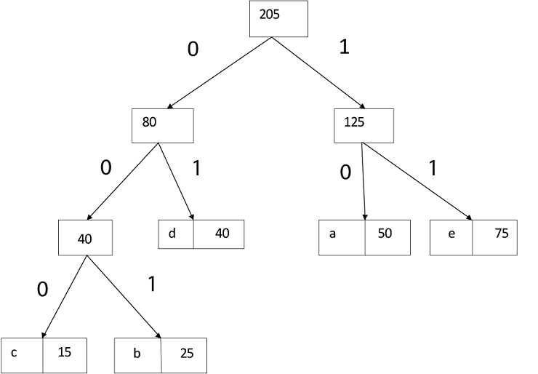
Thus, the final output is:

Slide 59
Fractional Knapsack
Fractions of items can be taken rather than having to make binary (0-1) choices for each item.
Fractional Knapsack Problem can be solvable by greedy strategy whereas 0 - 1 problem is not.
Steps to solve the Fractional Problem:
Compute the value per pound for each item.
Obeying a Greedy Strategy, we take as possible of the item with the highest value per pound.
If the supply of that element is exhausted and we can still carry more, we take as much as possible of the element with the next value per pound.
Sorting, the items by value per pound, the greedy algorithm run in O (n log n) time.

Slide 60
Fractional Knapsack
(Array v, Array w, int W)
for i= 1 to size (v)
do p [i] = v [i] / w [i]
Sort-Descending (p)
i ← 1
while (W>0)
do amount = min (W, w [i])
solution [i] = amount
W= W-amount
i ← i+1
return solution

Slide 61
Example:
Consider 5 items along their respective weights and values: -
I = (I₁,I₂,I₃,I₄,I₅)
w = (5, 10, 20, 30, 40)
v = (30, 20, 100, 90,160)
The capacity of knapsack W = 60
Now fill the knapsack according to the decreasing value of p_{i}.
First, we choose the item I_{i} whose weight is 5.
Then choose item I₃ whose weight is 20. Now,the total weight of knapsack is 20 + 5 = 25
Now the next item is I₅, and its weight is 40, but we want only 35, so we chose the fractional part of it,

Slide 62
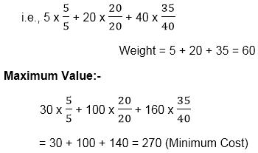

Slide 63
Solution:
ITEM | w_{i} | v_{i}
I₁ | 5 | 30
I₂ | 10 | 20
I₃ | 20 | 100
I₄ | 30 | 90
I₅ | 40 | 160

Slide 64
Taking value per weight ratio i.e. p_{i}=
ITEM | w_{i} | v_{i} | P_{i}=
I₁ | 5 | 30 | 6.0
I₂ | 10 | 20 | 2.0
I₃ | 20 | 100 | 5.0
I₄ | 30 | 90 | 3.0
I₅ | 40 | 160 | 4.0

Slide 65
Now, arrange the value of p_{i} in decreasing order.
ITEM | w_{i} | v_{i} | p_{i}=
I₁ | 5 | 30 | 6.0
I₃ | 20 | 100 | 5.0
I₅ | 40 | 160 | 4.0
I₄ | 30 | 90 | 3.0
I₂ | 10 | 20 | 2.0

Slide 66
Longest Common Sequence (LCS)
A subsequence of a given sequence is just the given sequence with some elements left out.
Given two sequences X and Y, we say that the sequence Z is a common sequence of X and Y if Z is a subsequence of both X and Y.
In the longest common subsequence problem, we are given two sequences X = (x₁ x₂....x_{m}) and Y = (y₁ y₂ y_{n}) and wish to find a maximum length common subsequence of X and Y. LCS Problem can be solved using dynamic programming.

Slide 67
Characteristics of Longest Common Sequence
A brute-force approach we find all the subsequences of X and check each subsequence to see if it is also a subsequence of Y, this approach requires exponential time making it impractical for the long sequence.
Given a sequence X = (x₁ x₂.....x_{m}) we define the ith prefix of X for i=0, 1, and 2...m as X_{i}= (x₁ x₂.....x_{i}).
For example: if X = (A, B, C, B, C, A, B, C) then X₄= (A, B, C, B)

Slide 68
Optimal Substructure of an LCS:
Let X = (x₁ x₂....x_{m}) and Y = (y₁ y₂.....) y_{n}) be the sequences and let Z = (z₁ z₂......z_{k}) be any LCS of X and Y.
If x_{m} = y_{n}, then z_{k}=x_m=y_{n} and Z_{k-1} is an LCS of X_{m-1}and Y_{n-1}
If x_{m} ≠ y_{n}, then z_{k}≠ x_{m} implies that Z is an LCS of X_{m-1}and Y.
If x_{m} ≠ y_{n}, then z_{k}≠y_{n} implies that Z is an LCS of X and Y_{n-1}

Slide 69
Travelling Sales Person Problem
The traveling salesman problems abide by a salesman and a set of cities. The salesman has to visit every one of the cities starting from a certain one (e.g., the hometown) and to return to the same city. The challenge of the problem is that the traveling salesman needs to minimize the total length of the trip.
Suppose the cities are x₁ x₂..... x_{n} where cost c_{ij} denotes the cost of travelling from city x_{i} to x_{j}. The travelling salesperson problem is to find a route starting and ending at x₁ that will take in all cities with the minimum cost.

Slide 70
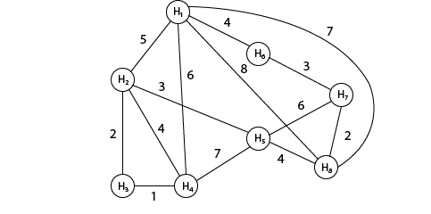
Example:
A newspaper agent daily drops the newspaper to the area assigned in such a manner that he has to cover all the houses in the respective area with minimum travel cost. Compute the minimum travel cost.
The area assigned to the agent where he has to drop the newspaper is shown in fig:

Slide 71
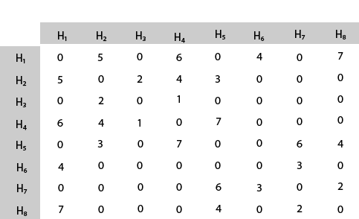
Solution: The cost- adjacency matrix of graph G is as follows:
cost_{ij} =

Slide 72
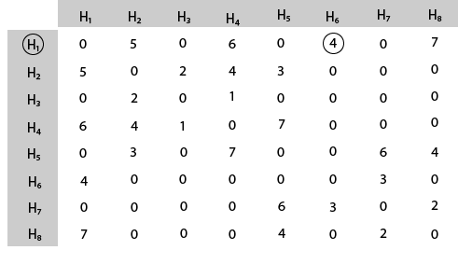
The tour starts from area H₁ and then select the minimum cost area reachable from H₁.

Slide 73
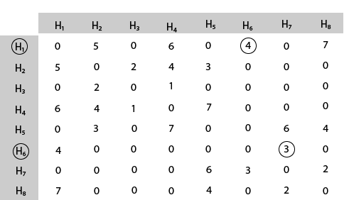
Mark area H₆ because it is the minimum cost area reachable from H₁ and then select minimum cost area reachable from H₆.

Slide 74
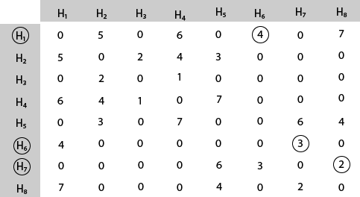
Mark area H₇ because it is the minimum cost area reachable from H₆ and then select minimum cost area reachable from H₇.

Slide 75
UNIT - III TOPIC – Graph and Tree Algorithms
BRANCH - CSE SEMESTER – 6th
SUBJECT- DAA

Slide 76
Graph Algorithms
A graph is a unique data structure in programming that consists of finite sets of nodes or vertices and a set of edges that connect these vertices to them.
At this moment, adjacent vertices can be called those vertices that are connected to the same edge with each other. In simple terms, a graph is a visual representation of vertices and edges sharing some connection or relationship.
Although there are plenty of graph algorithms that you might have been familiar with, only some of them are put to use.
The reason for this is simple as the standard graph algorithms are designed in such a way to solve millions of problems with just a few lines of logically coded technique. To some extent, one perfect algorithm is solely optimized to achieve such efficient results.

Slide 77
Types of Graphs
There are various types of graph algorithms that you would be looking at in this article but before that, let's look at some types of terms to imply the fundamental variations between them.
Order: Order defines the total number of vertices present in the graph.
Size: Size defines the number of edges present in the graph.
Self-loop: It is the edges that are connected from a vertex to itself.
Isolated vertex: It is the vertex that is not connected to any other vertices in the graph.
Vertex degree: It is defined as the number of edges incident to a vertex in a graph.
Weighted graph: A graph having value or weight of vertices.
Unweighted graph: A graph having no value or weight of vertices.
Directed graph: A graph having a direction indicator.
Undirected graph: A graph where no directions are defined.

Slide 78
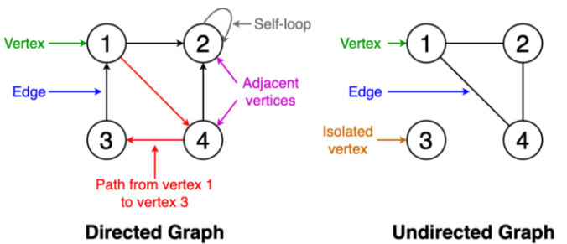
dg
bfg

Slide 79
Breadth-First Search
Traversing or searching is one of the most used operations that are undertaken while working on graphs. Therefore, in breadth-first-search (BFS), you start at a particular vertex, and the algorithm tries to visit all the neighbors at the given depth before moving on to the next level of traversal of vertices.
Unlike trees, graphs may contain cyclic paths where the first and last vertices are remarkably the same always. Thus, in BFS, you need to keep note of all the track of the vertices you are visiting.
To implement such an order, you use a queue data structure which First-in, First-out approach. To understand this, see the image given below.

Slide 80
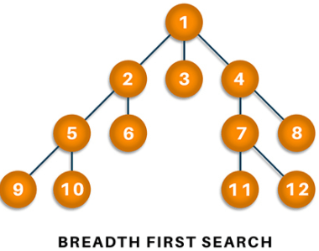

Slide 81
Algorithm
Start putting anyone vertices from the graph at the back of the queue.
First, move the front queue item and add it to the list of the visited node.
Next, create nodes of the adjacent vertex of that list and add them which have not been visited yet.
Keep repeating steps two and three until the queue is found to be empty.

Slide 82
Pseudocode
Set all nodes to "not visited";
q = new Queue();
q.enqueue(initial node);
while ( q ? empty ) do
{
x = q.dequeue();
if ( x has not been visited )
{
visited[x] = true; // Visit node x !
for ( every edge (x, y) /* we are using all edges ! */ )
if ( y has not been visited )
q.enqueue(y); // Use the edge (x,y) !!!
}
}

Slide 83
Complexity: 0(V+E) where V is vertices and E is edges.
Applications
BFS algorithm has various applications. For example, it is used to determine the shortest path and minimum spanning tree.
It is also used in web crawlers to creates web page indexes. It is also used as powering search engines on social media networks and helps to find out peer-to-peer networks in BitTorrent.

Slide 84
Depth-first search
In depth-first-search (DFS), you start by particularly from the vertex and explore as much as you along all the branches before backtracking.
In DFS, it is essential to keep note of the tracks of visited nodes, and for this, you use stack data structure.

Slide 85
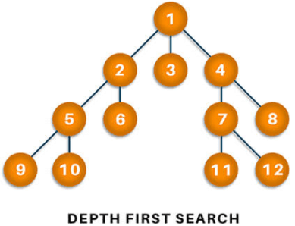

Slide 86
Algorithm
Start by putting one of the vertexes of the graph on the stack's top.
Put the top item of the stack and add it to the visited vertex list.
Create a list of all the adjacent nodes of the vertex and then add those nodes to the unvisited at the top of the stack.
Keep repeating steps 2 and 3, and the stack becomes empty.

Slide 87
Applications
DFS finds its application when it comes to finding paths between two vertices and detecting cycles.
Also, topological sorting can be done using the DFS algorithm easily. DFS is also used for one-solution puzzles.

Slide 88
Minimum Spanning Tree
A minimum spanning is defined as a subset of edges of a graph having no cycles and is well connected with all the vertices so that the minimum sum is availed through the edge weights.
It solely depends on the cost of the spanning tree and the minimum span or least distance the vertex covers.
There can be many minimum spanning trees depending on the edge weight and various other factors.

Slide 89
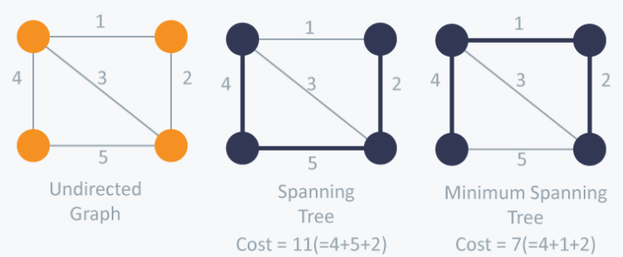

Slide 90
Applications
Minimum spanning tree finds its application in the network design and is popularly used in traveling salesman problems in a data structure.
It can also be used to find the minimum-cost weighted perfect matching and multi-terminal minimum cut problems.
MST also finds its application in the field of image and handwriting recognition and cluster analysis.

Slide 91
Topological sorting
Topological sorting of a graph follows the algorithm of ordering the vertices linearly so that each directed graph having vertex ordering ensures that the vertex comes before it.
Users can understand it more accurately by looking at the sample image given below.

Slide 92
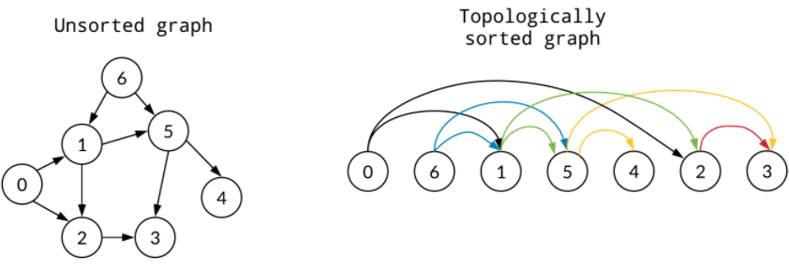
dg
In the above example, you can visualize the ordering of the unsorted graph and topologically sorted graph. The topologically sorted graph ensures to sort vertex that comes in the pathway.

Slide 93
UNIT - IV TOPIC – Tractable and Intractable Problems
BRANCH - CSE SEMESTER – 6th
SUBJECT- DAA

Slide 94
Tractable and Intractable Problems
Let’s start by reminding ourselves of some common functions, ordered by how fast they grow.
constant | O(1)
logarithmic | O(log n)
linear | O(n)
n-log-n | O(n × log n)
quadratic | O(n 2 )
cubic | O(n 3 )
exponential | O(k n), e.g. O(2n)
factorial | O(n!)
super-exponential | e.g. O(n n)

Slide 95
Tractable Problem: a problem that is solvable by a polynomial-time algorithm. The upper bound is polynomial.
Intractable Problem: a problem that cannot be solved by a polynomial-time algorithm. The lower bound is exponential.
• Here are examples of tractable problems (ones with known polynomial-time algorithms): –
Searching an unordered list
Searching an ordered list
Sorting a list
Multiplication of integers (even though there’s a gap) –
Finding a minimum spanning tree in a graph (even though there’s a gap)

Slide 96
NP-Completeness
A decision problem L is NP-Hard if
L' ≤p L for all L' ϵ NP.
Definition: L is NP-complete if
L ϵ NP and
L' ≤ p L for some known NP-complete problem L.' Given this formal definition, the complexity classes are:
P: is the set of decision problems that are solvable in polynomial time.
NP: is the set of decision problems that can be verified in polynomial time.
NP-Hard: L is NP-hard if for all L' ϵ NP, L' ≤p L. Thus if we can solve L in polynomial time, we can solve all NP problems in polynomial time.
NP-Complete L is NP-complete if
L ϵ NP and
L is NP-hard

Slide 97
Reductions
Concept: - If the solution of NPC problem does not exist then the conversion from one NPC problem to another NPC problem within the polynomial time. For this, you need the concept of reduction. If a solution of the one NPC problem exists within the polynomial time, then the rest of the problem can also give the solution in polynomial time (but it's hard to believe). For this, you need the concept of reduction.
Example: - Suppose there are two problems, A and B. You know that it is impossible to solve problem A in polynomial time. You want to prove that B cannot be solved in polynomial time. So you can convert the problem A into problem B in polynomial time.

Slide 98
UNIT - V TOPIC – Advanced Topics
BRANCH - CSE SEMESTER – 6th
SUBJECT- DAA

Slide 99
Approximate Algorithms
Introduction:
An Approximate Algorithm is a way of approach NP-COMPLETENESS for the optimization problem. This technique does not guarantee the best solution. The goal of an approximation algorithm is to come as close as possible to the optimum value in a reasonable amount of time which is at the most polynomial time. Such algorithms are called approximation algorithm or heuristic algorithm.
For the traveling salesperson problem, the optimization problem is to find the shortest cycle, and the approximation problem is to find a short cycle.
For the vertex cover problem, the optimization problem is to find the vertex cover with fewest vertices, and the approximation problem is to find the vertex cover with few vertices.

Slide 100
Performance Ratios
Suppose we work on an optimization problem where every solution carries a cost. An Approximate Algorithm returns a legal solution, but the cost of that legal solution may not be optimal.
For Example, suppose we are considering for a minimum size vertex-cover (VC). An approximate algorithm returns a VC for us, but the size (cost) may not be minimized.
Another Example is we are considering for a maximum size Independent set (IS). An approximate Algorithm returns an IS for us, but the size (cost) may not be maximum. Let C be the cost of the solution returned by an approximate algorithm, and C* is the cost of the optimal solution.

Slide 101
Vertex Cover
A Vertex Cover of a graph G is a set of vertices such that each edge in G is incident to at least one of these vertices.
The decision vertex-cover problem was proven NPC. Now, we want to solve the optimal version of the vertex cover problem, i.e., we want to find a minimum size vertex cover of a given graph. We call such vertex cover an optimal vertex cover C*.

Slide 102
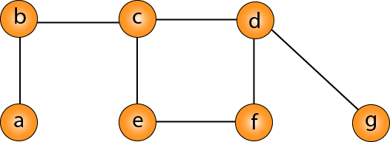

Slide 103
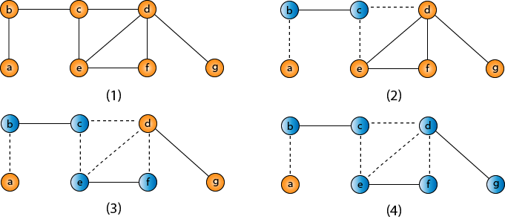
VC = {b, c, d, e, f, g}

Slide 104
Traveling-salesman Problem
In the traveling salesman Problem, a salesman must visits n cities. We can say that salesman wishes to make a tour or Hamiltonian cycle, visiting each city exactly once and finishing at the city he starts from. There is a non-negative cost c (i, j) to travel from the city i to city j. The goal is to find a tour of minimum cost. We assume that every two cities are connected. Such problems are called Traveling-salesman problem (TSP).
We can model the cities as a complete graph of n vertices, where each vertex represents a city.
It can be shown that TSP is NPC.

